Slide 1
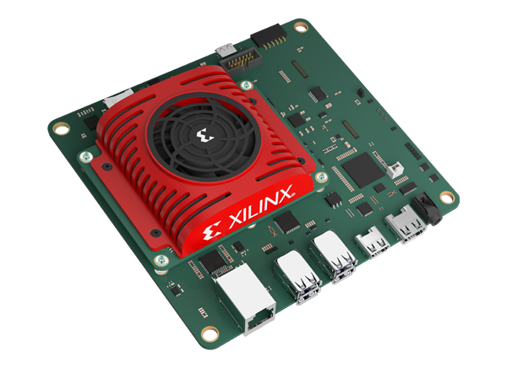
Machine Learning & Heterogeneous Computing for Real-time Eye Tracking
Members: Alek Comstock, Jeffery Kasper, Sandro Panchame, Rudolph Nahra
Advisor: Dr. Rover
Client: JR Spidell
Email: sddec23-02@iastate.edu
Ref: https://www.mouser.com/images/marketingid/2021/img/134666503.png
Notes:
https://seniord.ece.iastate.edu/resources/491_Final_Presentation.pdf
Alek Hello, I’m Alek comstock, I’m studying computer engineering, we are team 2, and our project is Maching learning and Heterogeneous computing for Realtime

Slide 2
Introduction
Notes:
alek Introduce myself, then the project
...eye tracking. I’m Alek comstock, I’m studying computer engineering (anything else to say about ourself?), and this is our project

Slide 3
The Project
Problem
Eye tracking can require very high frame rates (200+ FPS) to correctly capture some eye movement patterns, such as the saccade.
It is difficult to achieve these frame rates in an embedded system.
Solution
Accurate and fast eye tracking can be achieved using:
Heterogeneous hardware specialized for machine learning (ML)
Implemented on a field programmable gate array system on chip (FPGA SOC)
Using a custom ML model.
Notes:
Alek
Question? Why 200+? Some eye movements are too fast to capture with anything lower than 240FPS (to correctly capture saccade)

Slide 4
Requirements

Slide 5
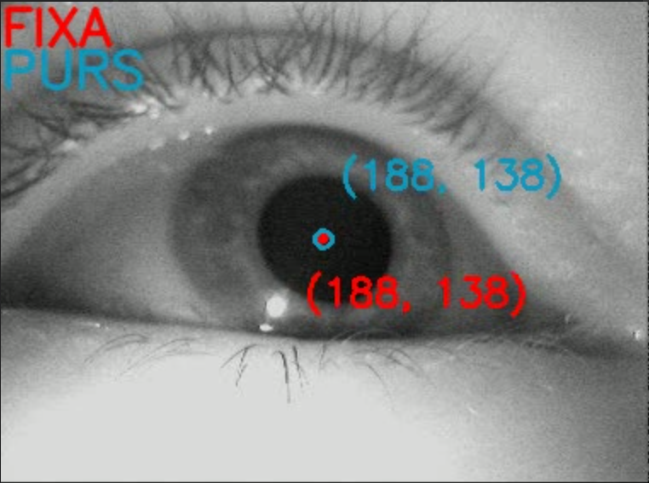
Requirements: Functional
Functional
Take in many images of eyes
Output position of pupil and open/close state
Notes:
Alek
(from video feed)
Possible questions: (?)

Slide 6
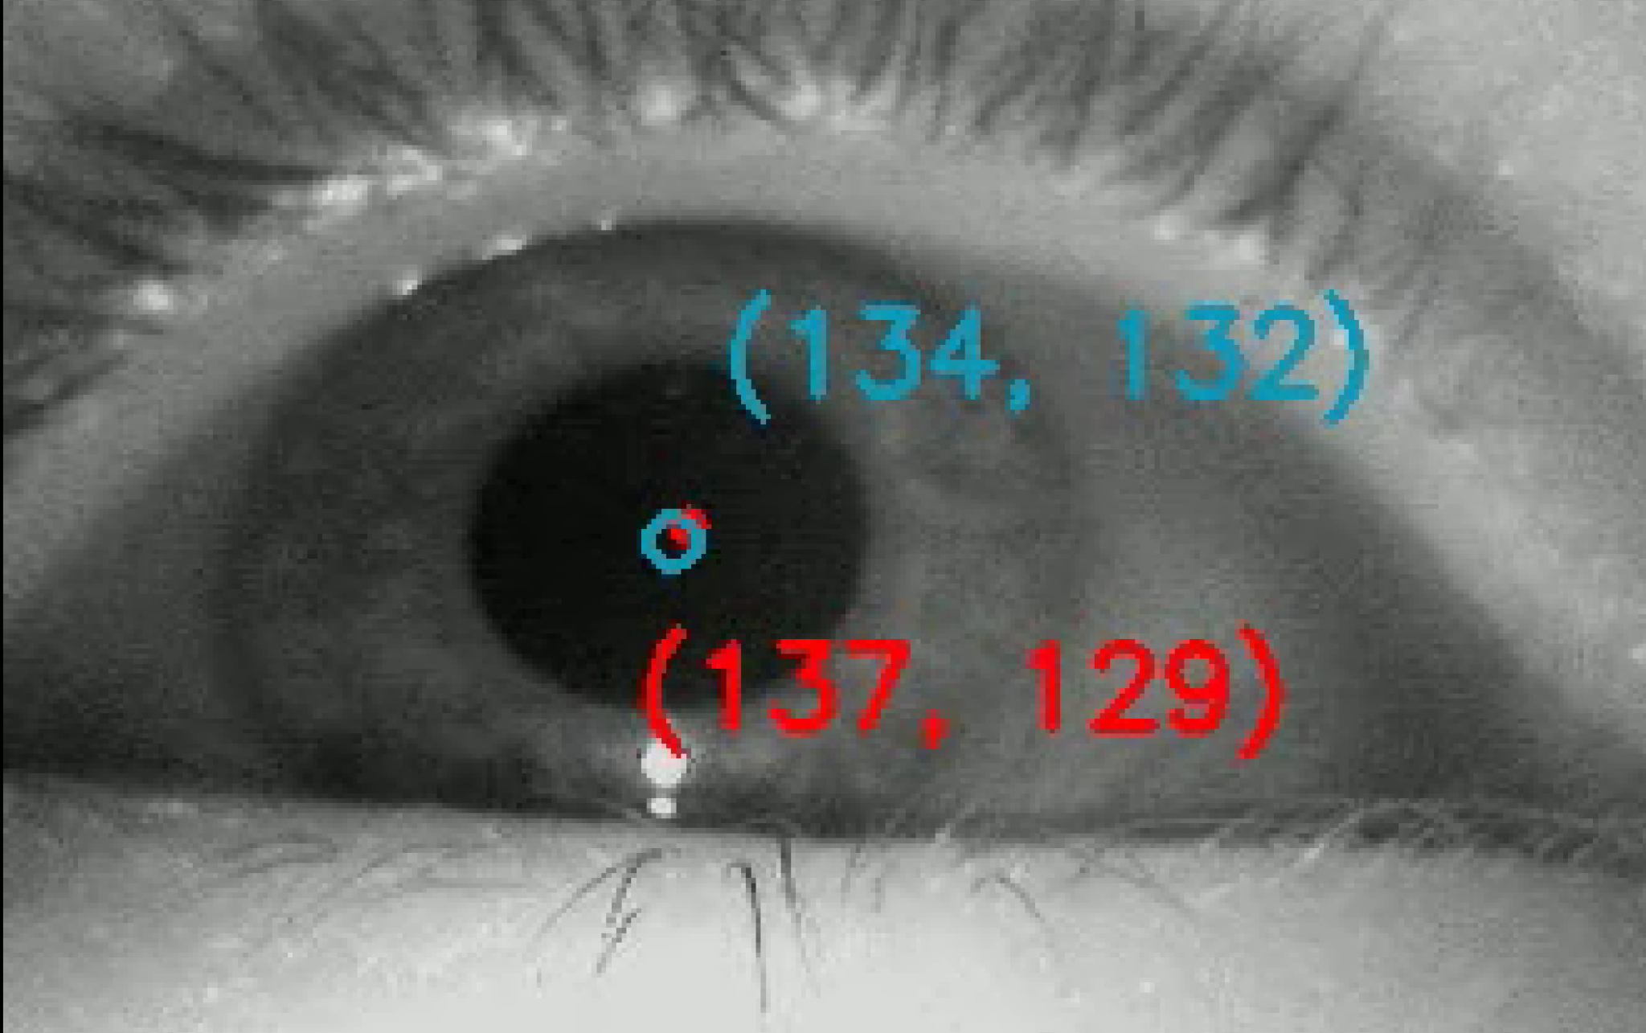
Requirements: Nonfunctional
Nonfunctional:
Process each frame of a video feed with enough throughput to keep up with incoming images
Root Mean Squared Error (RMSE) of pupil position estimation must be within 3 pixels of the ground truth
Usage of the Real-time Processing Units (RPU) to enable response to hard time constraints
Constraint:
Restricted to the Kria KV260 platform
Notes:
Alek
Anticipated Questions:
Ground truth? - annotated data, what we trained the ML on

Slide 7
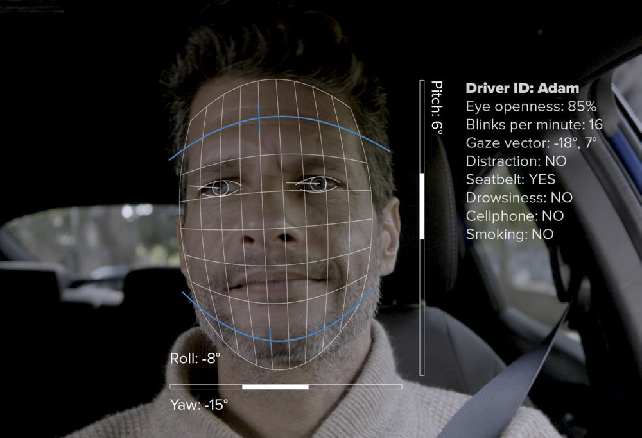
Possible Use Cases
Knowing the human’s eye movement tells you a lot about the state of that human.
This is helpful in cases where we want to, for example:
Monitor vehicle drivers (planes, automobiles, heavy machinery)
Diagnose diseases
Ref: https://cipia.com/driver-sense/
Notes:
Alek
Anticipated
What other factors may be important?
How is movement behavior determined

Slide 8
System Design: ML Model
Notes:
In System Design, we should probably discuss the ML first then the board

Slide 9
System Data Processing
Image preprocessing conducted before neural network
Neural network outputs an estimate of (X,Y) coordinates of pupil center
Results are reported
Notes:
Sandro
Anticipated Questions
Why resize the image?

Slide 10
Model Training: Dataset
Dataset sourced from TEyeD
Very large collection of real world near eye images
Annotations consisted of information such as landmark information, eyeball center, and movement classification
Roughly 28GB of data was used in training
The portion consisted of videos under two and half minutes in length
The rest of the dataset was left alone for testing purposes
Notes:
Sandro
Anticipated Questions
Why was a model architecture provided
Finding an appropriate architecture is difficult
Training the model took roughly 10 hours
What else was available within annotations?
Why under 2.5 minutes?
Why 70% of the data?
What other portions were available?
Is it actually the largest collection?
Claimed by the paper

Slide 11
Model Training: Architecture
Convolutional Neural Network
Provided Model Architecture
Notes:
Sandro
6 x (Conv->Dropout) -> Flatten->Dense
Anticipated Questions
Why a convolutional Neural Network?
Kernel sizes?
Number of filters?
Why flatten?
Why a dense layer?
Why this number of layers?

Slide 12
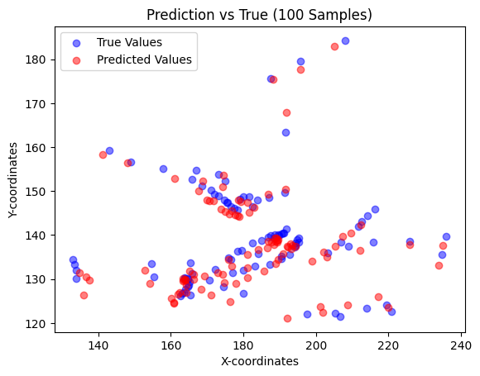
Model Training: Results
Multiple models were trained until we achieved the following result
Roughly 260,000 samples used in training
Loss function = RMSE
Model resulted in a RMSE of 2.54 pixels
Notes:
Sandro
Anticipated Questions:
What do the thresholds mean for the index?
How much of the data was trimmed from the control?

Slide 13
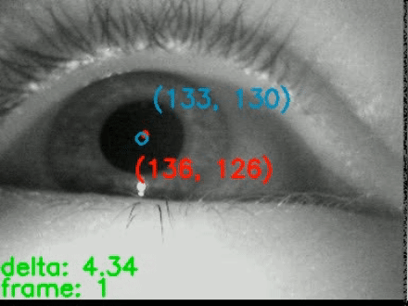
Clip
Blue = Ground Truth
Red = Predicted
Notes:
Sandro
Anticipated Questions:
What is the predicted and what is the actual?
What is the delta?
Why keep track of the frame?

Slide 14
Hardware
Kria KV260
Development board designed by Xilinx.
Contains a Kria K26 SOM FPGA.
Configured with a Deep-Learning Processing Unit (DPU).
4 ARM Cortex A53 cores running a Petalinux environment.
2 ARM Cortex R5 running in a bare metal environment.
4GB of Memory.
Ref: https://www.mouser.com/images/marketingid/2021/img/134666503.png
Notes:
Rudy

Slide 15
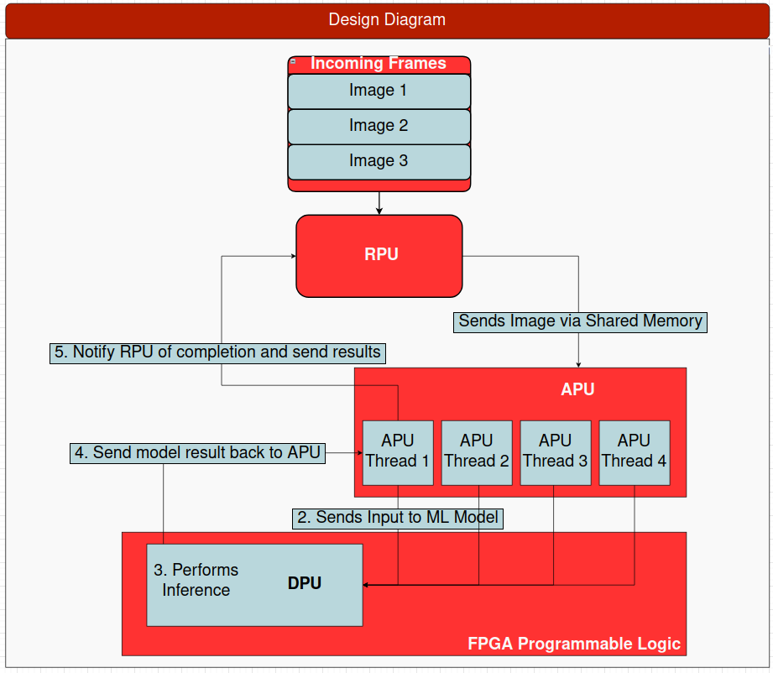
Heterogeneous Computing Elements
RPU
Real time processor
Bare metal
APU
4 ARM A53 processors
Linux-based OS
DPU
Deep Learning Processor
FPGA ML Accelerator
Notes:
Rudy

Slide 16
DPU Details
DPU can perform ML calculations with high parallelization
Instantiated in FPGA fabric as a systolic array
Takes instructions like any other processor
Instructions are compiled from the ML model into a *.xmodel file
APU feeds instructions to the DPU
Notes:
Rudy

Slide 17
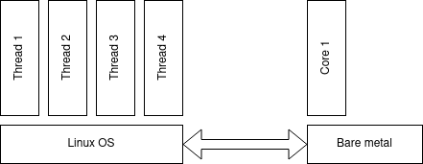
Heterogeneous Communication
OpenAMP
Framework facilitating communication between heterogeneous computing elements.
Allows sending small messages between APU and RPU via a shared memory region
Libmetal
OpenAMP only allows small messages
Need to transfer entire image
Libmetal enables management of large shared memory regions
Notes:
Jeffery

Slide 18
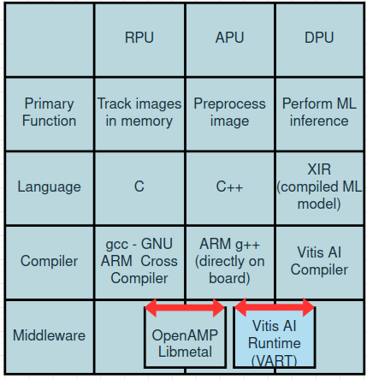
Software Tools by Processing Unit
RPU code developed with Xilinx Vitis
APU code developed directly on board
Hardware design created and synthesized using Xilinx Vivado
Notes:
Jeffery

Slide 19
Challenges Overcome

Slide 20
Accomplishments
Compile custom operating system (petalinux)
Careful creation of memory regions
Must compile with correct kernel settings and packages
Created and synthesized hardware design for FPGA
Trained the provided machine learning algorithm
Compiled XIR model of our trained machine learning algorithm
Implemented an algorithm for passing messages between heterogeneous computing modules
Accelerated model inference running on board
Notes:
Jeffery

Slide 21
Testing
Testing was performed on the Kria board
Video frames outside of training dataset were put on Kria file system
APU used DPU installed on FPGA to perform model inference
Results were compared to ground truth from dataset
We achieved RMSE of 2.54 pixels and 220 frames per second, meeting our accuracy and throughput objectives
Notes:
Jeffery
We didn’t meet use of the RPU

Slide 22
Marabou
Originally Neural Network Verification was a goal of our project
NN verification proves that the NN meets specification and does nothing else
Marabou uses formal methods for verification of NN
We learned that formal methods is computationally expensive
Currently, only possible to verify very small networks
Our network was too big
Notes:
Ripped from, “Where did my Pixels Go?” by Rudy Nahra
Neural Network Verification is hard because we are trying to search a potentially “infinite” range of inputs for some property.
We simply can’t do that without some simplifying assumptions.
Most mathematical tricks to solve systems of many variables involve abusing linearity, but neural networks must be nonlinear by design.
—---------------------------------------
We originally wanted to perform Nueral Network Verification
However, due to the nature of our goals, usage of Marabou presented np-complete issue
Marabou is meant to work with a small number of inputs
An image has a large number of inputs

Slide 23
Gantt Chart/Project Schedule
Notes:
Alek As you can see, we had a lot of parallel development, as we were training and building the neural network, we were also developing our RPU and APU code bases

Slide 24
Next Steps
Receive image feed from camera
Integrate with larger project
Reduce error of neural network
Verify neural network
Optimize processing algorithms to achieve higher frames per second
Notes:
Alek

Slide 25
Questions?

Slide 26
END

Slide 27
END

Slide 28
END

Slide 29
Appendix

Slide 30
Resources
TEyeD
https://arxiv.org/pdf/2102.02115v3.pdf
NN Verification
https://aisafety.stanford.edu/marabou/fomlas19.html#/sec-architecture-overview
https://www.youtube.com/watch?v=KiKS_zaPb64
Remodnav
Dar, A.H., Wagner, A.S. & Hanke, M. REMoDNaV: robust eye-movement classification for dynamic stimulation. Behav Res 53, 399–414 (2021). https://doi.org/10.3758/s13428-020-01428-x

